Slide 1

PRODUCT KNOWLEDGE

Slide 2

SUPPLIERS
LINEAR Chemicals, S.L.
- is a Spanish company established in 1994 with activities in the developing, manufacturing of In Vitro Diagnostics (IVD) products including different Instrument and Reagents covering Clinical Chemistry, Serology, Urinalysis, Haematology and Immunology and marketing them under the brand name Cromatest, Clonatest, Plus-Sed and Linear.
- Exclusive distributor since 2009.
Montgat, Spain.
AVANTOR Performance Materials
- is the new incarnation of two companies instrumental in establishing today’s global chemical and materials industries: Mallinckrodt company – established in 1867; and JT Baker Chemical company established in 1904.
- Pennsylvania, USA (other offices: Netherlands, China, India, Malaysia and etc.)
- Haematology Analyzer and reagents, ELISA and CLIA reagents, Immunology analyzers.

Slide 3
RAYTO Life and Analytical Sciences Co., Ltd.
- a Chinese company established in 2005.
- Shenzhen, China
- Haematology and Chemistry Analyzers.
NUVE Laboratory and Sterilization Technology
- has been well-known as a manufacturer of reliable laboratory instruments for 4 decades.
- Ankara, Turkey
- Laboratory and Medical equipment (such as centrifuges, incubators, water baths, autoclaves, microbiology hoods and etc.)
ARON Laboratory Instruments Inc.
- established in 1971 in Taiwan and specializes in producing laboratory and medical instruments.
- Taipei, Taiwan
- Laboratory and Medical equipment (such as centrifuges, incubators, water baths, autoclaves and etc.)

Slide 4
CHUNGDO Pharm. Co., Ltd.
- established in 1991 and a manufacturer of diagnostic products.
- Gangwon-do, Korea
- Urine Analyzer and urine strips
LONCARE Medical Technology Co., Ltd
- core business field is in In VITRO Diagnostics (IVD), focuses on Biochemistry, Haematology, Immunology, Urinalysis, including various instruments, reagents, consumables and some related products.
- Shenzhen, China
- Haematology reagents
SEILER Instrument Inc.
- has been providing high-quality optics and service to the medical industry for over 66 years.
- Missouri, USA
- Compound Microscopes
Meizhou CORNLEY Hi-Tech Co., Ltd.
- was founded in 1993 and a co-partner of Shenzhen Medicong Medical Electronics Co., Ltd.
- Shenzhen, China
- Electrolytes Analyzers and consumables

Slide 5
SENOVA Biotech Co., Ltd.
- specializes in medical equipment, laboratory equipment, healthcare equipment and consumables.
- Shanghai, China
- Vacuum Blood tubes
NINGBO Fuchun Co., Ltd.
- offers high-quality medical products which China has been exporting world-wide.
- Ningbo, China
- Medical and Laboratory supplies
LONGFIAN Scitech Co., Ltd.
- is a professional manufacturer that specializes in the development, production and export of medical serial oxygen concentrators.
- Baoding, China
- Ultrasounds, ECG machines, pulse oximeter and etc.

Slide 6
PRODUCT LINE
LABORATORY
    REAGENTS
    EQUIPMENT
    SUPPLIES/CONSUMABLES
IMAGING / RADIOLOGY
    EQUIPMENT
    SUPPLIES/CONSUMABLES
MEDICAL
OTHERS

Slide 7
LABORATORY - REAGENTS
Controls
Calibrators
CHEMISTRY
  Chromatest
    - Linear
    - Semi-Automated Chemistry Analyzer (TEMIS, C61)
    - wet method
  Kromatest
  - Linear
  - Automated Chemistry Analyzers
  (Kroma, BS120, BS320, BS200, etc)
  - wet method

Slide 8
Serology
  Rapid Tests
    - Linear, CTK, Intec, Avantor
    - HbsAg, Pregnancy Tests/B-HCG (Serum/Urine), Anti-HAV, etc.
    - no machines required
  Febrile Antigens
  - Linear
  - Widals Tests (Salmonella Typhi A and B,
  Salmonella Paratyphi O and H)
  - no machines required
  Radial Immunodiffusion
  - Linear, Caliper
  - C3 id, C4 id

Slide 9
  Latex
  - Linear
  - CRP(C-Reactive Protein), ASOT (anti-Streptolysin O Test), RF (Rheumatoid Factor)
  - no machines required
  - presence and absence of agglutination.
  - rapid slide tests
  -Qualitative and Semi-Quantitative
  Turbidimetric
  - Linear
  - CRP, ASOT, RF , C3
  - TEMIS and other Semi-Automated Chemistry Analyzers
  - KROMA and other Automated Chemistry Analyzers
  - Quantitative

Slide 10
Immunology
  ELISA
    - Linear (96T), Avantor (24T, 42T, 96T)
    - Enzyme Linked Immunosorbent Assay
    - uses Antibodies and color change to identify a substance
    - T3, T4, TSH, FT3, FT4, TPSA
    - GEA Microplate Reader, SAGA Microplate Washer, Incubator
  CLIA
  - Avantor (24T, 96T)
  - Chemiluminescence Assay
  - it is the emission of light as a result of a chemical reaction
  - Lumace (Microplate Luminometer), washer

Slide 11
Microscopy
  Feccal Occult Blood
    - Linear
    - qualitative test to determine occult blood or hidden blood in the feces
    - cassette
  Urine Strips
  - Chungdo
  - most common is the 4SG and the 10parameters

Slide 12
Hematology
  Coagulation
    - Linear
    - Protime (Prothrombin Time), APTT (Activated Partial Thromboplastin Time), Fibrinogen
  ESR Tubes
  - Linear (VacuSed) automated, uses ESR Analyzers (IRIA, LENA)
  - Ningbo –pink tube with volume of 1mL
  Automated Hematology Reagents
  - Rayto (RT-7100), Loncare (RT-7100, BC1800, BC-5500), Avantor (H32)

Slide 13
LABORATORY - EQUIPMENT
CHEMISTRY
  TEMIS
    - Linear
    - Semi-Automated Clinical/Chemistry Analyzer (TEMIS)
    - could run HbA1c and other quantitative Serologic Tests

Slide 14
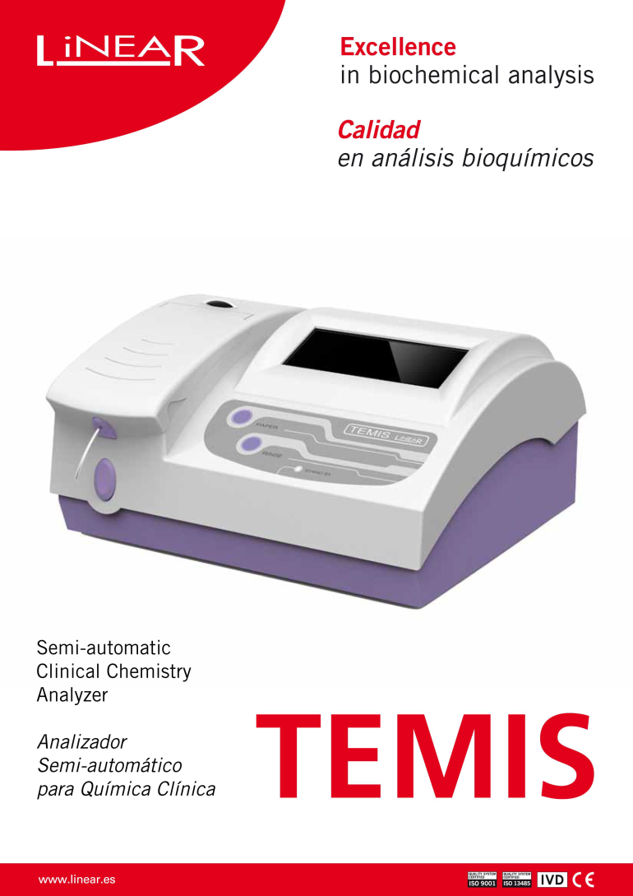
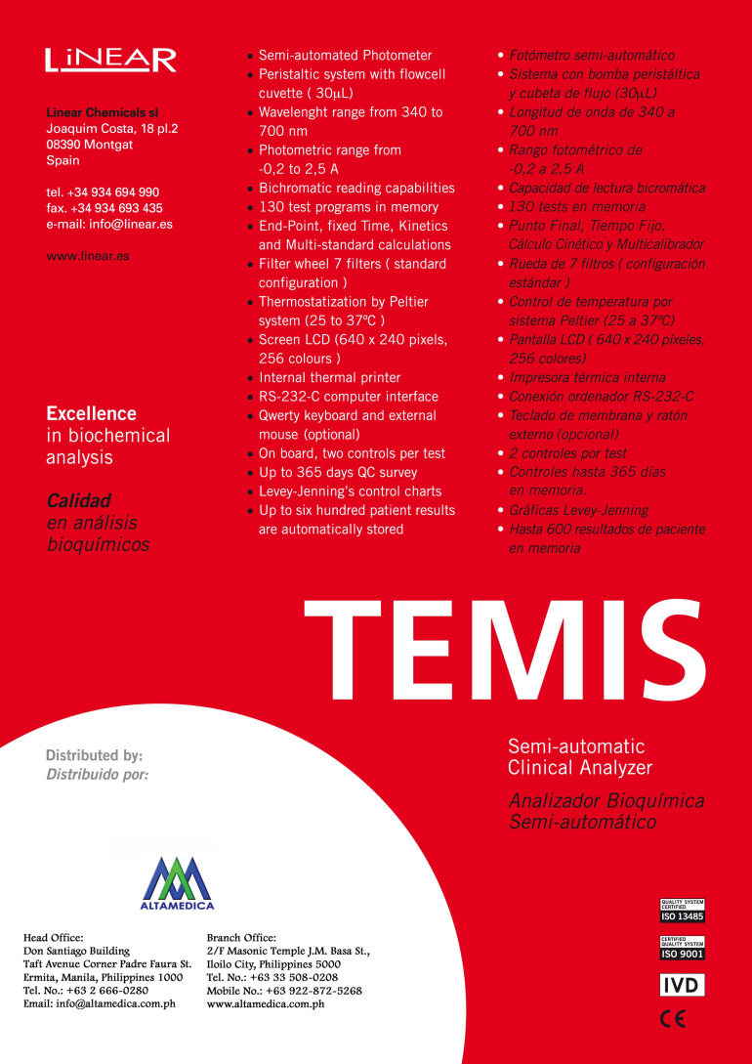

Slide 15
LABORATORY - EQUIPMENT
CHEMISTRY
  C61
  - Avantor
  - Semi-Automated Chemistry Analyzers

